Slide 1

Personal Development at Fordbridge
Vision for PD
Achievements this year in PD
Links to whole school priorities
Monitoring of PD
Inclusion and Equality within PD.
Focus for next year for PD.

Slide 2
Our Vision for Personal Development at Fordbridge Community Primary School
At Fordbridge, we believe education is about more than academic achievement — it's about nurturing the whole child. Our Personal Development curriculum is designed to support children in becoming confident, compassionate, and capable individuals, ready to thrive in a complex and diverse world.
We focus on the spiritual, moral, cultural, mental, and physical development of every pupil, helping them understand their place in society both locally and globally. Through meaningful experiences, we empower children to face moral, social, and cultural challenges with integrity and resilience.
Our curriculum promotes responsible citizenship by encouraging an understanding of rights and responsibilities, and preparing pupils for the opportunities and challenges of adult life.
Beyond the classroom, we offer inclusive and creative experiences that spark curiosity and ambition. Our school provides a wealth of extra-curricular clubs, ranging from performing arts and sports to technology, academic enrichment, and STEM activities — ensuring every child can discover and develop their unique talents. With the support of families, staff, and community partners, we also provide enriching vocational opportunities that raise aspirations and broaden horizons for every child.

Slide 3

Achievements this year in your subject
Collaboration for the MAT to re-brand Fordbridge Futures as Flourishing Futures (see brochure).
35 extra-curricular clubs ran each term.
20 Flourishing Futures vocational sessions held each term for Y3-6. Including external support from NEC Summer term in; catering, construcyion, events, tech and recruitment and marketing.
Absolute Education introduced as a tracking system for all opportunities beyond the classroom (see next slide for scores on the doors)
Trips/residentials well attended (planned over a child’s time at FB to ensure range of experiences).
Dojo Bank successfully re-launched (new Digital Champion currently being trained to take over)
Relationships with key local national stakeholders supports with enhancing personalised experiences such as graduation as well as supporting with maintaining school environment through volunteering scheme and Christmas drives (NEC Group)
Careers Day in Year 6 (exposure to over 30 different careers; many of which were ex- pupils).
Parental survey evidenced positive responses to Personal Development.
Equality Silver Mark through EqualiTeach achieved.
SEND and Inclusion Award through SENDIA 70% complete as per interim review (deadline October 2025).
100% of sports comps attended (with at least ¼ entering more than 1 team). In addition, separate SEND comps are also attended with more than one team.
Assemblies run on a bi-weekly basis (Where in the World and a Values picture story) which exposes children to current events as well as stories linked to protected characteristics and our school values to reflect the rich and diverse community we serve.

Slide 4
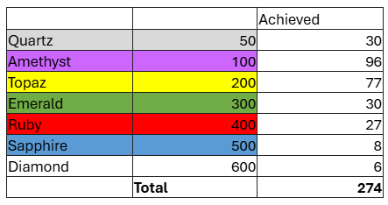
Achievements this year in your subject
274 children attending graduation at ICC in Birmingham and 400 parents/carers.
Curriculum regularly reviewed to ensure representation, diversity, ‘fit for purpose’, considers the community we serve and inspires… whilst adhering to NC.
PSHE opportunities include: HSBC lessons to support economic knowledge, Blue Cross pet safety, DHL Road Safety, Life Base, Loudmouth (Y5-6), Ned (show to support resilience), NSPCC assembly, water/winter safety, Walk to School week, Scootability, Bikeability, Kindness cards initiative.
Significant days/ weeks through PSHE team recognised such as Yellow Day/ Mental Health Day, as well as national charity days such as Red Nose Day and Children in Need.
Values Champions continue to be referred to across all elements of school which now include sporting ‘values champions’ to continue to embed and ‘develop pupil’s character’.
Pioneers developed across a range of subjects (Music/Art/DT/PE/Flourishing Futures).

Slide 5
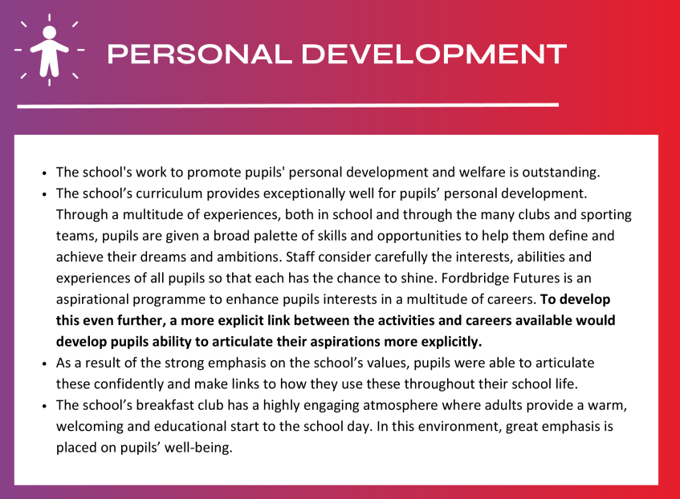
MAT Review
*Target now achieved through 2x DT sessions dedicated to re-launch of Flourishing Futures with clear guidance and time to plan for these sessions to ensure a more vocational approach.

Slide 6
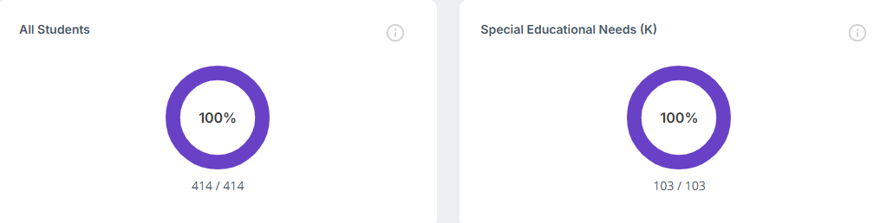
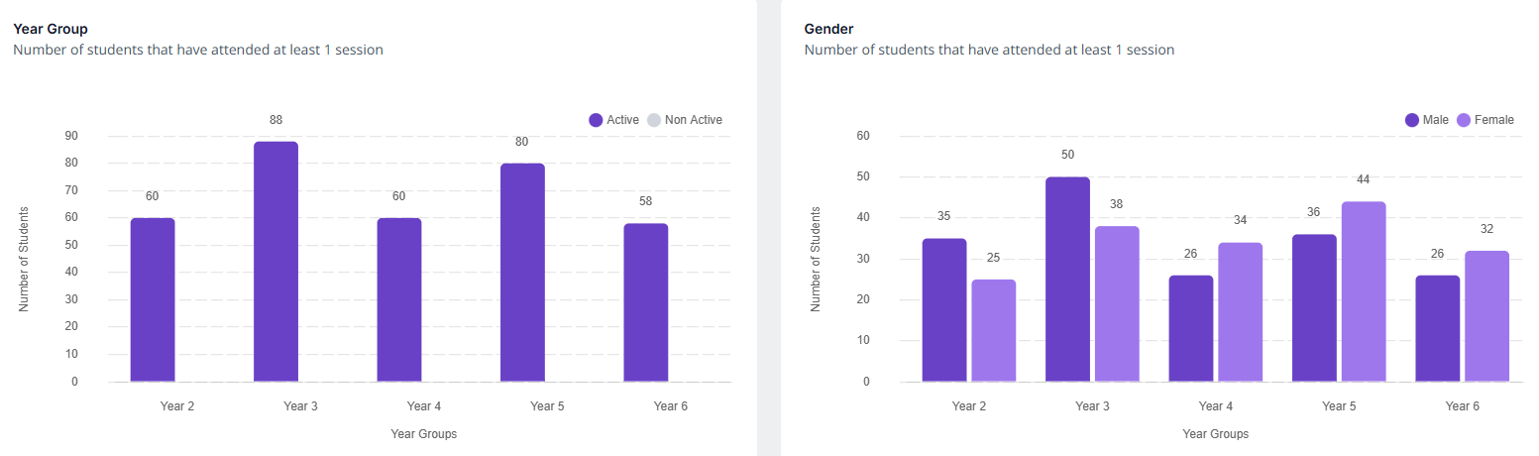
Achievements this year - DATA
100% of all pupils attended either an extra-curricular club or competition this academic year; inclusive of pupil premium children and pupils with SEND.
XXXX children from Y2-6 achieved 100 extra-curricular hours this year.
Parent views (out of 214 responses)
100% of pupils attend an after school club.
99.5% of pupils enjoy a club.
97.2% felt that it linked to and support the curriculum.
98.6% - supports wider development
93% supports with attendance
97.7% supports with behaviour (no red cards attend) – suspensions halved this academic year (both number of pupils and sessions missed).
Over 90% said extra-curricular opportunities were excellent. 8% ‘good’
*Lower participation for girls in Y2&6 – pupil voice to be taken Summer 1.
*Girls higher in Y4-6 due to large numbers in choir.

Slide 7

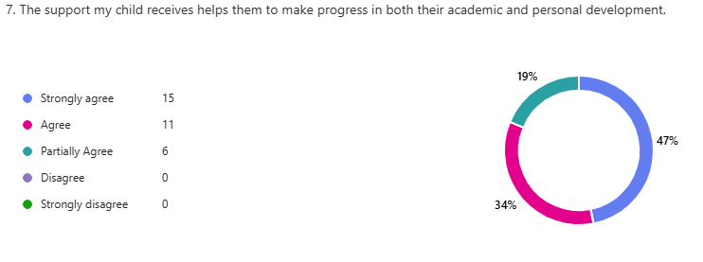
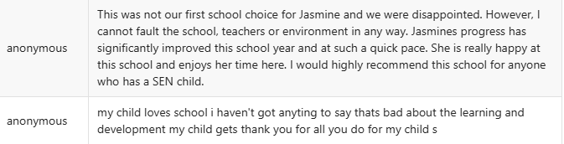
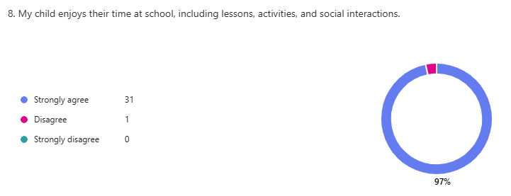
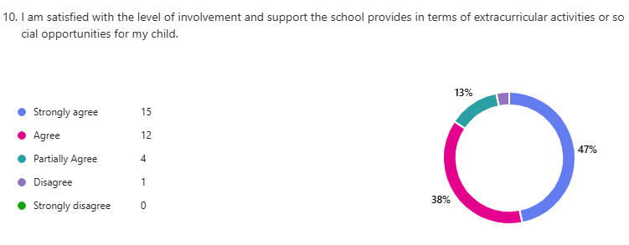
SEND and PD

Slide 8
Monitoring of your subject
Absolute Education – extra –curricular data
Parental Surveys through parentmails/Microsoft forms/1:1 meetings/ SEND review meetings.
INSIGHT/Birmingham continuums – to track individual progress/attainment
CPOMS – behaviour
Pupil voice through school council meetings and monitoring.
Curriculum/PD/SEND reviews (external/MAT).

Slide 9
Focus for next year…
Look into gaining UNICEF accreditation.
Develop clubs further to ensure consistent attendance to all clubs.
Secure ICC for a second year for graduation.
Achieve Birmingham Airport bid (for third time). Both on behalf of FF and school to develop Launch Pad.
To continue to develop links with local and national stakeholders to supplement curricular and extra-curricular offer.
To develop Flourishing Futures programme within EYFS.
To embed Flourishing Futures programme in KS1 and KS2.

